Slide 1
IEEE “Advancing Technology
For Humanity”
Central Texas Section Humanitarian Project
Leslie Martinich
IEEE CTS Chair
September 16, 2017
Notes:
Note: This talk is for the Summit on Technology and Healthcare, so I’ve started with a slide showing how technology advances healthcaare.
Jennifer Doudna invented the gene splicing technology, Crispr.
Dr. John Tisdale has used the technology to make a breakthrough in healthcare. He has found a way to cure Sickle Cell disease, which previously had no cure and caused those afflicted to suffer terrible pain and shortened life spans. I believe he has cured 60 people so far at the National Institutes of Health. The patient shown above is Diedre Williams, who lives in Round Rock, and who is cured.

Slide 2
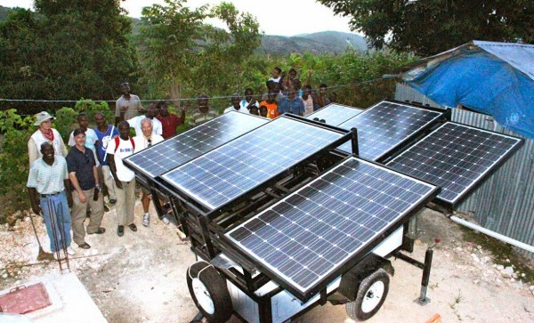
IEEE Members Helping Communities
The first IEEE CSI-Sirona SunBlazer being installed in St. Étiènne, Haiti – 2011
Notes:
As engineers, we can all contribute to advancing technology for humanity.
Here a group of IEEE volunteers built solar powered, movable systems to help communities get electricity in Haiti after their earthquake.

Slide 3

Providing Electricity to Remote Villages
Notes:
Another group of IEEE volunteers helps small villages (which have previously had no electricity) to get electricity, through the use of small systems.

Slide 4
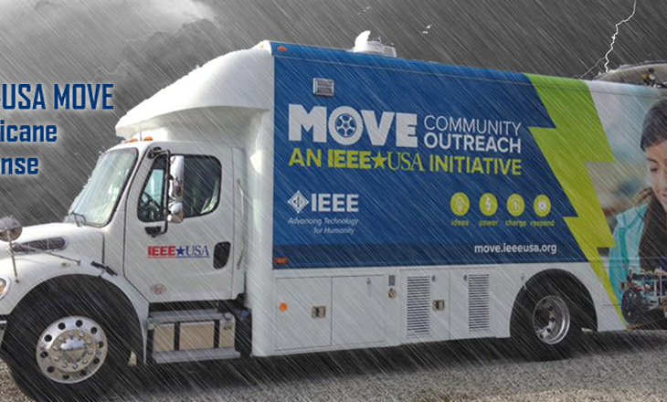
Partner with Red Cross to Provide Power and Battery Charging Stations
Notes:
Another group of IEEE Volunteers has conceived the idea of a truck that can serve communities devastated by floods and hurricanes.
They have partnered with the Red Cross.
The Red Cross often uses the MOVE truck as its first “office” in a disaster area, until they can obtain a real office.
The MOVE truck supplies communications and power, providing battery recharging for local victims of disasters a way to recharge their devices.
This is a picture of the MOVE truck on the way to Hurricane Harvey.

Slide 5
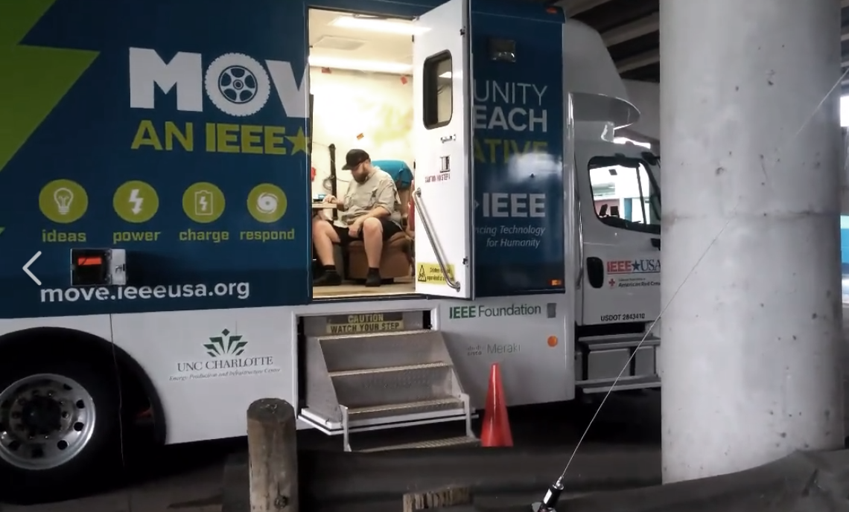
Partner with Red Cross to Provide Power and Battery Charging Stations
Notes:
This is a picture of workers configuring systems during Hurricane Harvey. They are in a parking garage. They later had to move because it got flooded.

Slide 6
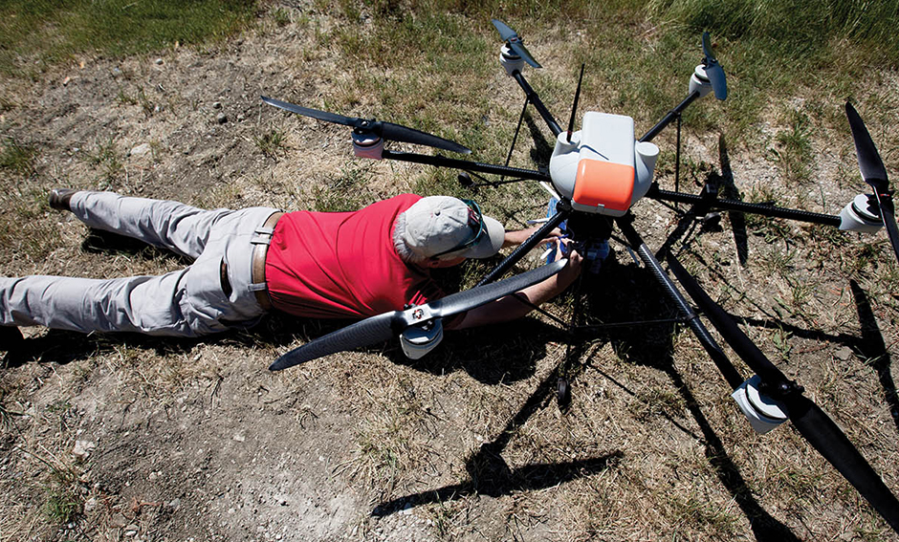
Drones and Cell Towers
Notes:
Often when disaster strikes, cell towers are knocked out, making it difficult for first responders to get people in need. One of our engineers in North Texas has come up with a plan to attach cell towers to drones, allowing service to be sent it to whereever it is needed.

Slide 7
With the Support of IEEE
We Can Do Something AWESOME!
What Would YOU Like to Do???
Join us to decide on a project!
  9/19 Women in Engineering Book Club at Cirrus Logic
We’ll announce plans on IEEE Day, Oct 3
Contact me: Leslie Martinich lmartinich@ieee.org
Notes:
This is the call to action.
What do our members want to do? We can do something big!
We’ll have multiple meetings to discuss this and make a selection on 9/19.
We will then announce our plans on IEEE Day, Oct 3.
That will be our chance to enlist people who are interested and kick off the project.

